Slide 1
Milestone 3: Prayer Notebook
Building a RESTful API with Node.js, Express, and MySQL

Slide 2
Project Overview
Technology Stack:
Node.js - JavaScript runtime
Express - Web framework
TypeScript - Type-safe coding
MySQL - Database
Postman - API testing
What the API Does:
Manages prayer requests
Organizes prayers into categories
Tracks answered prayers
Supports full CRUD operations (Create, Read, Update, Delete)

Slide 3
API Endpoints Created
Prayer Endpoints
GET all prayers
GET prayer by ID
GET prayers by category
GET answered prayers
Search prayers by keyword
CREATE new prayer
UPDATE prayer
MARK prayer as answered
DELETE prayer
Category Endpoints
GET all categories
GET category by ID
CREATE category
UPDATE category
DELETE category

Slide 4
Challenges Encountered
1: TypeScript Type Errors
Problem: Red underlines on req.params.id and req.query.userId
Why: TypeScript did not know these would be strings
Solution: Added as string type assertions
parseInt(req.params.id as string)
2: Database Connection Issues
Problem: Connection pool errors during development
Why: Forgot to initialize MySQL connector before routes
Solution: Call initializeMySqlConnector() before setting up routes

Slide 5
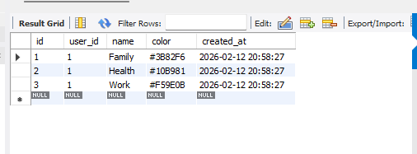
Categories Table in MySQL
3 categories created:
Family (blue: #3B82F6)
Health (green: #10B981)
Work (orange: #F59E0B)
Each category linked to user_id 1

Slide 6
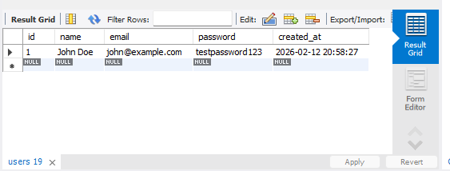
Users Table in MySQL
Why This Matters:
All prayers and categories are linked to this user (user_id = 1)
Foreign key relationships ensure data integrity
Users can only access their own prayers

Slide 7
Pending Bugs and Issues
1. Authentication System
Users must manually pass userId in every request
Risk: Anyone can access any user's prayers if they know the userId
Fix Needed: Implement JWT tokens or session authentication
2. No Request Logging
Only using console.log() for debugging
Problem: Logs disappear when server restarts
Fix Needed: Add Winston or Morgan logging libraries
Benefit: Save all API requests to files for debugging
3. No Rate Limiting
No protection against spam requests
Risk: Someone could flood the API with requests
Fix Needed: Add express-rate-limit middleware
Example: Limit to 100 requests per hour per user
4. Passwords Not Hashed (HIGH PRIORITY)
Issue: Storing plain text passwords in database
Risk: Major security vulnerability
Fix Needed: Use bcrypt to hash passwords

Slide 8
Lessons Learned
Planning Saves Time
Having the database design and API endpoints planned in Milestone 1 and 2 made coding much faster
Following the design document prevented mistakes and confusion
Lesson: Always design before coding.
TypeScript Catches Errors Early
Type checking found bugs before running the code
Red underlines helped fix issues immediately
Lesson: Type safety is worth the extra effort
3. Testing is Essential
Testing each endpoint in Postman immediately after creating it caught problems fast
Verifying database changes prevented data corruption
Lesson: Test early and often
4. Code Organization Matters
Separating Models, DAOs, Controllers, and Routes made code easy to find and fix
Following MVC pattern kept everything organized
Lesson: Good structure makes maintenance easier

Slide 9
Summary
Milestone 3 Achievements
Built complete backend REST API with 14 endpoints
Implemented full CRUD operations for prayers and categories
Created MySQL database with 3 related tables
Followed REST conventions (plural nouns, HTTP verbs, hierarchical URLs)
Used TypeScript for type safety
Organized code with MVC architecture
Tested all endpoints with Postman
Verified database changes with MySQL Workbench
Documented everything in README.md
Pushed code to GitHub

